Slide 1
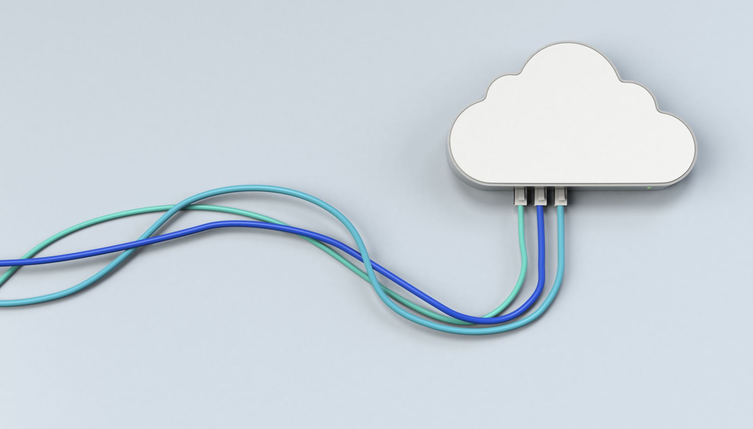
Introduction to Cloud Computing
Week 1
Introduction, Evolution &
Enabling Technologies
CS-4037
Muhammad Sudais
muhammad.sudais.v@nu.edu.pk

Slide 2
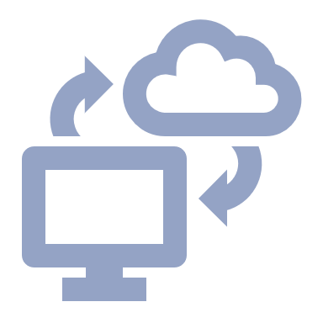
Course Outline
Introduction to Cloud Computing – History, Benefits & Challenges
Cloud Computing Models and Services
Cloud Security and Virtualization
Overview of popular cloud services
Azure Fundamentals
Azure Compute, Storage, Integration & Networking Services
Resource Management and Scaling in Azure
Cloud Infrastructure, Monitoring and DevOps on Azure
Service-Oriented Architecture (SOA) & Content Delivery Networks (CDN)

Slide 3
Books & References
Textbooks:
Sandeep Bhowmik. 2017. Cloud Computing (1st. ed.). Cambridge University Press.
Jonah Carrio Andersson. 2023. Learning Microsoft Azure. O'Reilly Media, Inc. ISBN 9781098113322.
Reference Books:
Rajkumar Buyya et al. 2013. Mastering Cloud Computing - Foundations and Applications Programming. Morgan Kaufmann Publishers Inc.
K. Chandrasekaran. 2015. Essentials of Cloud Computing. CRC Press.

Slide 4
Marks Distribution (Tentative)
Sessional Exams
25%
Assignments
10%
Quizzes
10%
Project
10%
Class Participation
5%
Final Exam
40%

Slide 5
Project
Students will choose their project topic or select from the list of sample ideas
Work in teams of 5
Design, implement, and evaluate cloud applications.

Slide 6
Project
Students will choose their project topic or select from the list of sample ideas
Work in teams of 5
Design, implement, and evaluate cloud applications.

Slide 7
Project Overview
This project focuses on developing a cloud-based application utilizing various Microsoft Azure services. The application will have user authentication, API integrations, and cloud storage, and will be deployed on Azure.

Slide 8
Functional Requirements
Application:
Develop a basic application using ASP.NET, Python, etc. with user authentication.
User Features:
CRUD functionality, register/login.
API Integration:
Expose APIs securely using Azure API Management.
Azure Function:
Add event-driven features.
Cloud Hosting:
Host the application on Azure App Service.
Database:
Use Azure SQL or Cosmos DB.
Storage:
Integrate Azure Blob Storage for file management.

Slide 9
Non-Functional Requirements
Performance:
The application should handle at least 100 concurrent users.
Scalability:
The system must auto-scale based on load.
Availability:
Target 99.95% uptime.
Security:
Ensure encryption and access control.
Cost Optimization:
Use techniques for cost-effective resource management.

Slide 10
Azure Services Overview
Compute:
Azure App Service, Function Apps.
Storage:
Azure Blob Storage, Azure File Storage.
Database:
Azure SQL Database, Cosmos DB.
Security:
Azure Active Directory, Key Vault.
Monitoring:
Azure Monitor, Application Insights.
Networking (Optional):
Azure Virtual Network, Traffic Manager.

Slide 11
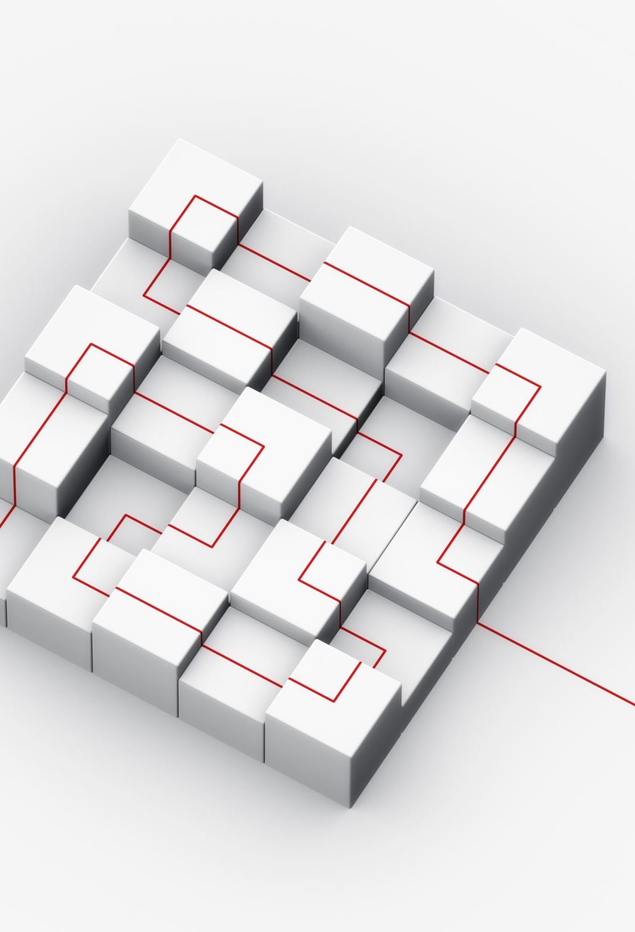
Project Milestones
Milestone 1 (Week 2):
Submit proposal with architecture and group details.
Milestone 2 (Week 4):
Submit architecture design and diagram.
Milestone 3 (Week 8):
Initial deployment with authentication and database integration.
Milestone 4 (Week 12):
Complete functionality with monitoring and optimization.
Milestone 5 (Week 16):
Submit full project and present.

Slide 12
Sample Project Ideas
1. E-Commerce Platform
2. Inventory Management System
3. Restaurant Ordering System
4. Learning Management System (LMS)
5. Blog Content Management System
6. Online Bookstore
7. Fitness Tracking App
8. Event Ticketing System
9. Travel Booking System
10. Healthcare Patient Management System
11. Serverless Video Sharing Platform
12. Personal Finance Tracker
13. Serverless Polling and Voting System
14. Real-Time Weather Forecasting Dashboard
15. Employee Timesheet Management System

Slide 13
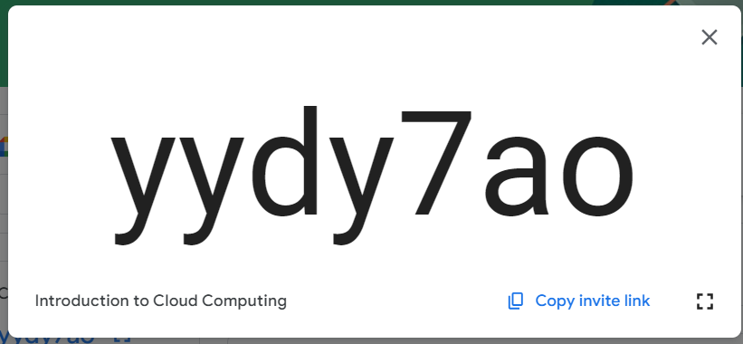

Google ClassRoom Code

Slide 14
CHAPTER 1 Introduction
|Cloud Computing

Slide 15
Cloud Computing
Cloud Computing is the delivery of computing services over the internet
IBM
Cloud computing is a model of computing where scalable and elastic IT-related capabilities are provided as a service to external customers using Internet technologies.
Microsoft Azure
Cloud computing is the delivery of computing services—including servers, storage, databases, networking, software, and more—over the cloud (the Internet) to offer faster innovation, flexible resources, and economies of scale.
Amazon Web Services (AWS)
Cloud computing is the on-demand delivery of IT resources via the internet with pay-as-you-go pricing. Instead of buying and managing physical servers and other datacenter infrastructure, you simply pay for what you use when you use it.
Google Cloud
Cloud computing refers to the delivery of computing services over the internet—everything from servers, storage, databases, networking, software, analytics, and intelligence.

Slide 16
What is the Buzz About?
Current Trends and Hype
“Cloud computing is the next big thing in IT.”
Increased adoption of cloud services and solutions.
Impact on Business and Technology
Transformation of IT operations
Cost benefits and scalability

Slide 17
What is the Buzz About?
Ease of Access: Users can easily access computing resources whenever and wherever needed.
No Infrastructure Setup: Users do not need to worry about setting up infrastructure, purchasing equipment, or procuring licensed software.
Cost-Effective: Users can access any volume of computing facilities in exchange for a nominal payment.
Modern Integration: Cloud computing is made possible through the integration of advanced computing models, sophisticated web technologies, and modern network communication technologies (especially high-speed Internet).
Recent Popularity: Although cloud computing became a hot topic for major vendors (e.g., Amazon, Google, Microsoft) from mid-2008, the concept itself is quite old.
Perceptions:
Some view it as a new and radical innovation.
Others see it as an evolution of existing technologies and modernization.
Technology Evolution: Cloud computing has emerged from existing technology domains and its context, much like every new technology.

Slide 18
Limitations of Traditional Computing Approaches
High Costs: Hardware, maintenance, and upgrades
Scalability Issues: Difficulty in handling fluctuating demands
Complex Management: Need for extensive IT resources
Limited Accessibility: Physical constraints and location dependency

Slide 19
Is there Any Solution TO These Worries
Two Options for Setting Up IT Infrastructure:
In-House Setup: Deploy an internal team to manage IT infrastructure.
Outsourcing: Transfer responsibility to a third-party provider with expertise.
Concerns in Both Options:
Hardware Management: Maintenance and upgrades.
Software Installation: Ensuring compatibility and updates.
Application Implementation: Handling and integrating new applications.
Core Competency: These tasks may not align with the core competencies of users or organizations.

Slide 20
Is there Any Solution TO These Worries
IT Service Outsourcing:
Popularity: Adopted by enterprises to manage application development and implementation.
Limitations: Traditional outsourcing addresses some concerns but doesn’t fully resolve all issues.
Challenges of Traditional Outsourcing:
Varied Requirements: Different levels of computing facility subscribers have diverse needs.
Complex Tasks: IT service organizations may have specific requirements for application development, whereas other teams (e.g., maintenance) have different needs.
Layer-Specific Issues: Difficulties depend on the computing layers users are working with.
Potential Solution:
Cloud Computing: Can potentially remove worries related to hardware, software, and application management by providing scalable, on-demand resources and services, allowing users to focus on core tasks.

Slide 21
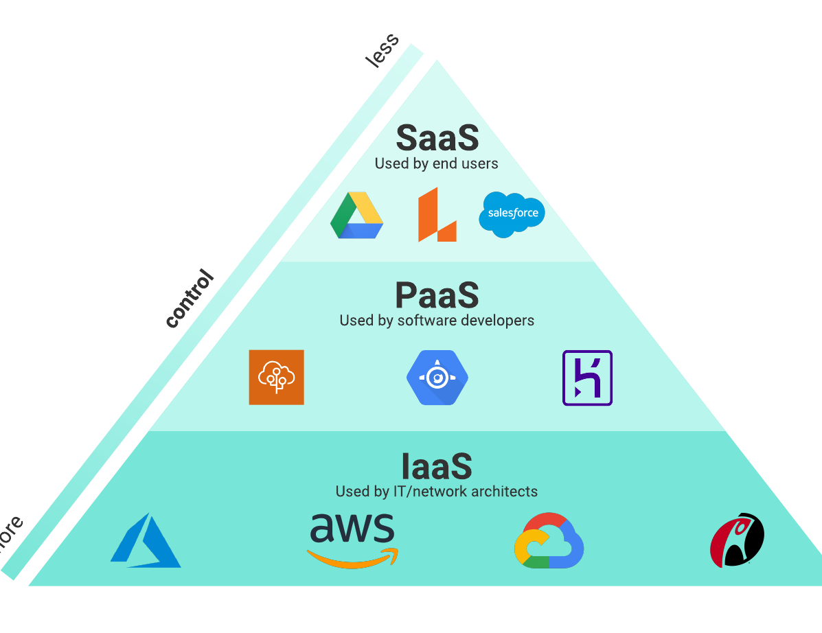
Three Layers of Computing
Infrastructure: “The foundation of cloud services.”
Hardware and virtual resources
Platform: “Tools and frameworks to build applications.”
Development tools and frameworks
Application: “End-user software delivered over the cloud.”
Software applications and services

Slide 22
THREE LAYERS IN TRADITIONAL COMPUTING
Hardware: Physical servers and storage
Operating System: Software managing hardware resources
Applications: User-facing software and tools

Slide 23
THE END OF TRADITIONAL COMPUTING
In traditional approach, computing subscribers were always over-burdened with many additional difficulties and costs
Shift to Cloud-Based Solutions:
Decline in demand for on-premises hardware
Increase in cloud adoption across industries
Transition Challenges: Migration strategies and integration

Slide 24

THE END OF TRADITIONAL COMPUTING
Limitations of Traditional Computing:
Longstanding Issues: Traditional computing faced limitations that had been evident for some time.
Futuristic Ideas: Various advanced computing techniques were proposed but could not be implemented due to technological constraints.
Technological Advancements:
Breakthroughs: Advances in computing and network communication technology enabled new possibilities.
Emergence of Cloud Computing: During the latter half of the last decade, a new computing model emerged.

Slide 25
THE END OF TRADITIONAL COMPUTING
Cloud Computing Model:
Philosophy: The model proposes delivering all computing facilities as services.
Three Main Layers:
Infrastructure: Hardware resources.
Platform: Development tools and frameworks.
Application: Software applications.
Delivery Model: These layers are provided as ready-made services, managed and maintained by the service providers.
Benefits:
Convenience: Consumers are relieved from the burden of arranging and managing their own computing resources.
On-Demand Services: Resources are available as needed, reducing the need for extensive in-house management.

Slide 26

Story of a Similar Scenario: A Century Ago
Early 1900s Electricity Generation:
In-House Production: Firms, especially manufacturers, generated their own electricity.
Burden: Required maintaining large infrastructure and a dedicated team.
Emergence of Power Grids:
Shift to External Supply: Firms began sourcing electricity from external providers.
Advantages:
No more managing coal deliveries.
Reduced need for specialized staff.
Concerns:
Reliability of power grids.
Security of supply lines.
Risk of vendor shutdowns.
Resolution:
Cost Efficiency: External suppliers offered lower costs compared to in-house generation.
Reliability: Over time, external power grids proved to be secure, reliable, and cheaper.
Outcome: By 1930, using external power grids became the norm, showing significant advantages over in-house generation.

Slide 27

Story of a Similar Scenario: A Century Ago
Moral of the Story:
Comparing to Cloud Computing:
Outsourcing IT Services: Similar to outsourcing electricity, cloud computing allows users to outsource IT services.
Benefits:
Users can access computing resources without managing their own infrastructure.
Only need to focus on usage and billing.
Modern Analogy: Just as external power grids became preferable; cloud computing services are likely to be more advantageous compared to maintaining internal IT setups.
Recommendation:
Adopt Cloud Computing: Continuing with internal IT infrastructure might be less efficient and more costly compared to leveraging cloud computing services, much like sticking to in-house electricity generation proved to be in the past.
This comparison highlights the evolving nature of technology and the benefits of adopting newer, more efficient models of service delivery.

Slide 28
Story of a Similar Scenario: A Century Ago
Historical Context:
Comparison with the industrial revolution
Transformation from manual labor to mechanized processes
Lessons Learned: Adaptation and innovation

Slide 29
People are Already Using Cloud Computing
Current Usage Trends:
Widespread use of cloud services in various sectors
Examples of cloud applications in everyday life
Case Studies: Organizations leveraging cloud computing for efficiency

Slide 30
Influences behind Cloud Service Adoption
Key Drivers:
Cost savings and financial benefits
Increased agility and flexibility
Technological advancements and innovation
Market Trends: Growth statistics and adoption rates
The idea of Cloud Computing is access anytime, anywhere, with any device

Slide 31
Influences behind Cloud Service Adoption Technological Influences:
Universal Network Connectivity: Connection around the globe
High Performance Computing: HPC affordable for everyone
Commoditization: Turns products into commodities that can be marketed.

Slide 32
Influences behind Cloud Service Adoption OPERATIONAL & BUSINESS Influences:
Low-Cost Solution
Outsourcing
Speed or Responsiveness
Automation
Small Initial Investment
Less Maintenance Cost
Mobility
Flexibility

Slide 33

Summary and Key Takeaways
Recap of Key Points:
Evolution from traditional to cloud computing
Benefits and drivers of cloud adoption
Future Outlook: Trends and expected developments in cloud computing

Slide 34
CHAPTER 2 Evolution and Enabling Technologies
|Cloud Computing

Slide 35
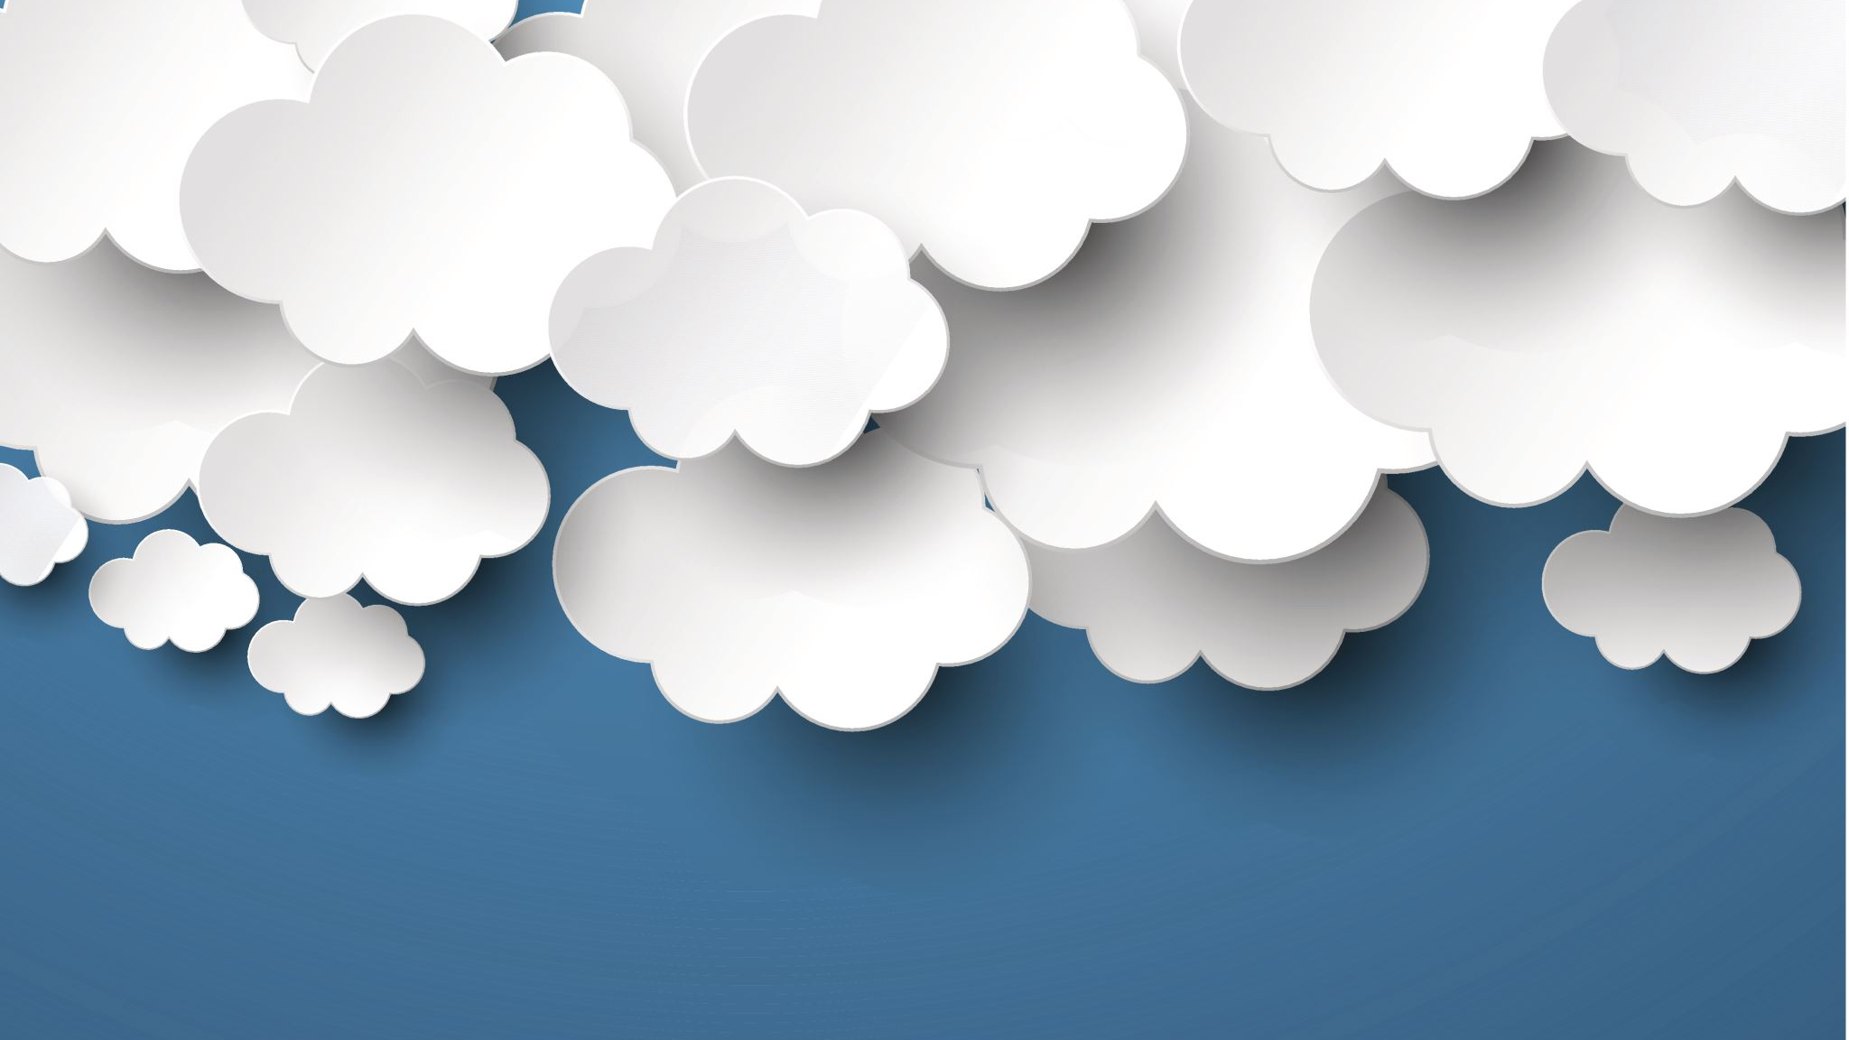
Evolution & ENABLING of CLOUD Computing
Gradual Development
Cloud computing is not an abrupt innovation but a result of decades of advancements in computing technology.
Historical Context:
The idea of cloud computing dates back to the 1960s.
John McCarthy's Vision: He suggested that "computation may someday be organized as a public utility."
Technological Advancements:
Over time, progress in hardware, communication, and web-based software architecture enabled the realization of cloud computing.
The development of the Internet played a crucial role in changing how computing services were delivered.

Slide 36
Evolution & ENABLING of CLOUD Computing
Overcoming Limitations:
Earlier technological constraints prevented cloud computing from becoming a reality.
Advancements in associated fields overcame these limitations, making cloud computing possible.
Evolution of Computing Models:
The chapter traces the evolution of cloud computing through stages:
Centralized Computing
Client-Server Computing
Distributed Computing
Grid Computing
Cloud Computing
Cloud as a Public Utility:
Cloud computing has finally realized the vision of computing as a public utility, providing on-demand services to users.

Slide 37
Evolution of CLOUD Computing
Several decades of research, particularly in the domain of parallel and distributed computing, have paved the way for cloud computing

Slide 38
Evolution OF CLOUD COMPUTING
Mainframe Architecture: In the 1970s, organizations used expensive, large mainframes for tasks like payroll management. Time-sharing systems allowed multiple users to access the same computer resources concurrently, reducing the need for multiple mainframes. Dumb terminals were used to access the mainframes remotely.
Intelligent Terminal and Client-Server Computing: As processing demands grew, technologists developed intelligent terminals (or client systems) capable of minimal processing. This led to client-server computing, where the load was partially shifted from servers to clients.
PC Revolution: The introduction of personal computers (PCs) in the 1970s further reduced dependence on mainframes. Organizations could perform all computing tasks locally on affordable PCs, which decreased the need for time-sharing systems.

Slide 39
Evolution OF CLOUD COMPUTING
Network of PCs and Peer-to-Peer Computing: As PCs became widespread, the need for direct communication between distant computers emerged. The development of LAN and WAN technologies enabled peer-to-peer (P2P) computing, allowing PCs to act as both clients and servers, decentralizing control.
Parallel and Distributed Computing: By the 1980s, parallel processing and distributed computing were introduced. Parallel processing allowed multiple processors to work on a task simultaneously, while distributed computing combined multiple systems to create a powerful computing network.
Cluster Computing: Clusters of interconnected computers performing similar tasks provided faster execution by distributing jobs across multiple nodes. Clustering also introduced the concept of resource pooling, improving reliability through redundancy.

Slide 40
Evolution OF CLOUD COMPUTING
Grid Computing: Grid computing took cluster computing a step further by decentralizing control and allowing nodes to perform tasks without a central 'head.' This architecture could scale across geographic locations and accommodate heterogeneous systems.
Hardware Virtualization: Virtualization allowed the decoupling of software systems from physical hardware, enabling dynamic resource scaling. This introduced the concept of virtual machines (VMs), which could simulate physical systems and manage resources more flexibly.
Advancement in Web Services: The growth of web services, particularly with Web 2.0, facilitated group collaboration over the web. This enabled real-time collaboration across geographically dispersed users, making it easier to integrate and share data across platforms.

Slide 41
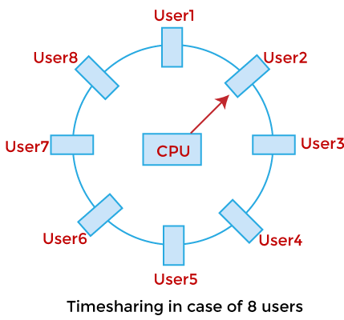
Evolution OF CLOUD COMPUTING : Mainframe Architecture
Mainframe Architecture: Introduction of Time-Sharing System
Early computing (1970s) used mainframes for data processing (e.g., payroll).
Time-sharing allowed multiple users to access a single mainframe.
Dumb terminals enabled remote access to centralized systems, but without local processing power.
1970s

Slide 42
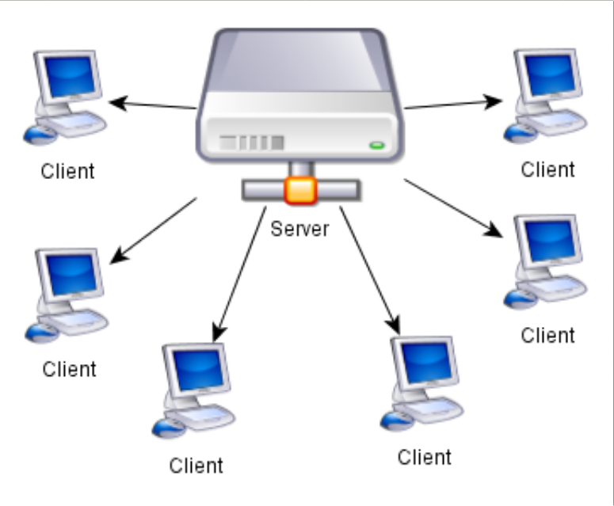
Evolution OF CLOUD COMPUTING : Intelligent Terminal
Intelligent Terminal: Beginning of Client-Server Computing
Dumb terminals were limited in handling concurrent tasks.
Intelligent terminals with some processing power emerged due to low-cost microprocessors.
This was the beginning of client-server computing, reducing load on central servers by distributing tasks.
1970s

Slide 43
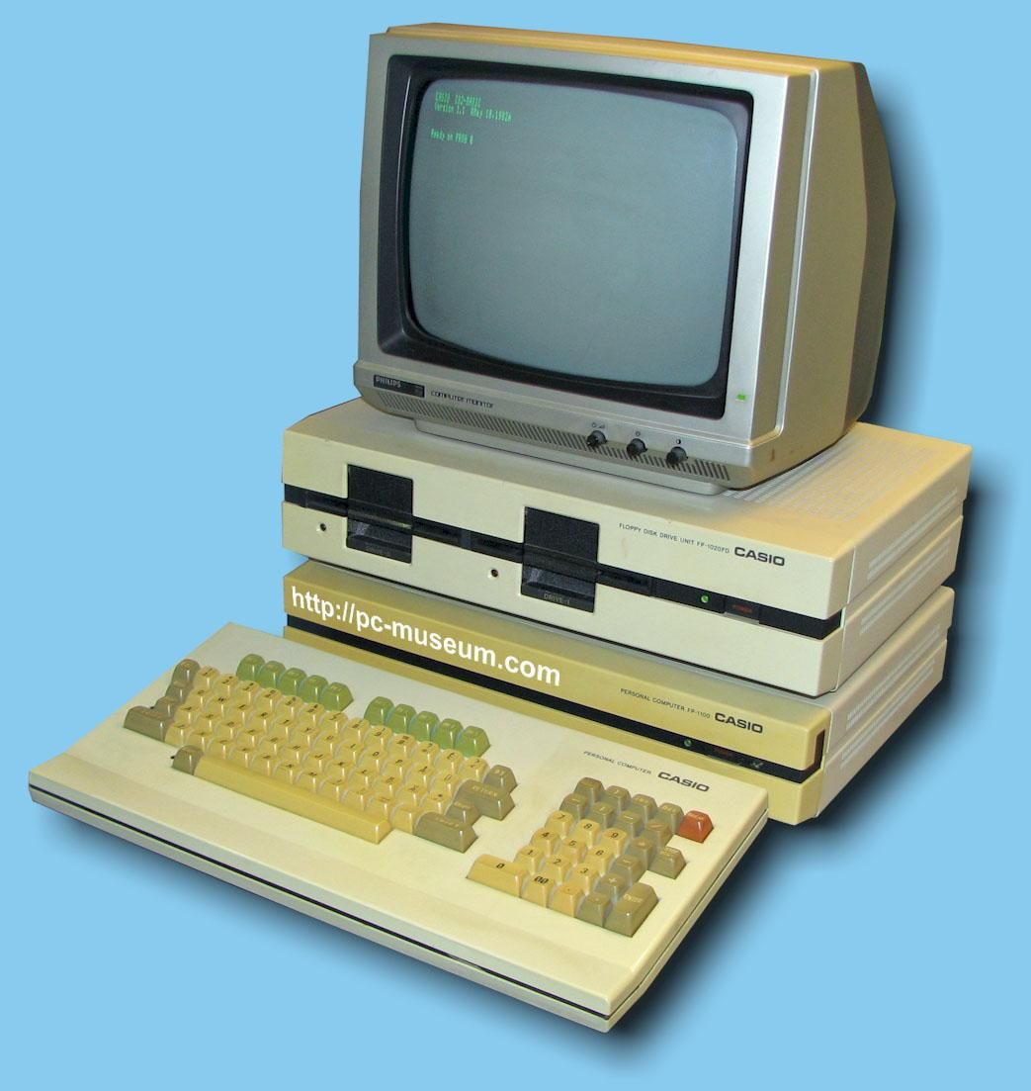
Evolution OF CLOUD COMPUTING : The PC Revolution
The PC Revolution: Scope for Computing Everything Locally
Microprocessors enabled personal computers (PCs) to perform tasks locally.
PCs were affordable, reducing reliance on expensive mainframe systems.
This allowed organizations to handle more computing tasks internally.
Mid 1970s

Slide 44
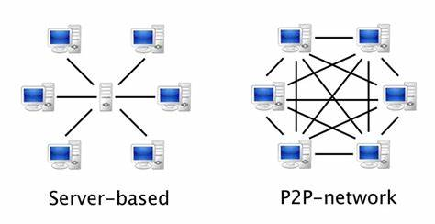
Evolution OF CLOUD COMPUTING : PEER TO PEER
Network of PCs: Emergence of Direct or Peer-to-Peer Communication
Organizations installed multiple PCs, but they couldn't communicate directly.
Network communication (LAN, WAN) solved this issue, enabling PCs to communicate without needing a central server.
Peer-to-peer (P2P) computing emerged, decentralizing control.

Slide 45
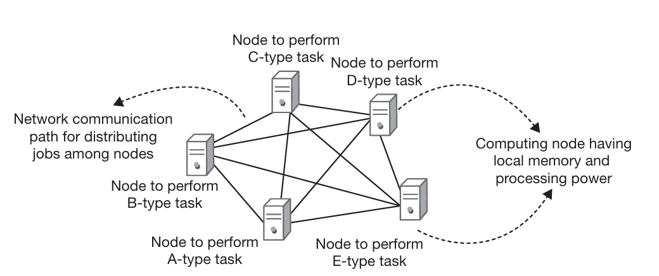
Evolution OF CLOUD COMPUTING : DISTRIBUTED COMPUTING
Fast Network Communication: Laid the Way for Distributed Computing
Parallel processing (multiple processors solving a task) was a key innovation.
Distributed computing extended this concept, allowing multiple computers to work together as one system.
Faster network communication enabled distributed computing to function efficiently.
1980s

Slide 46
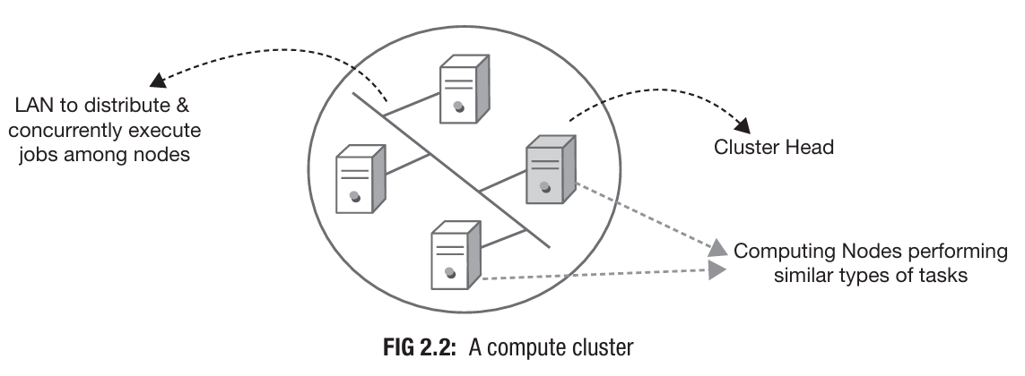
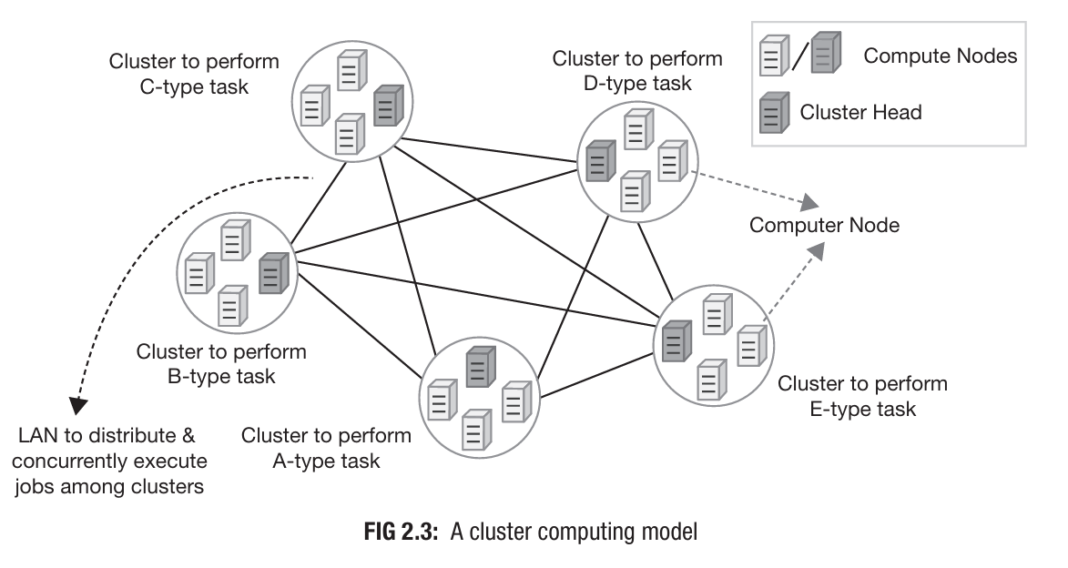
Evolution OF CLOUD COMPUTING : Cluster Computing
Cluster Computing: Creation of Resource Pool
Clustering allowed multiple nodes to work together, appearing as a single system.
Nodes shared computing tasks, creating a more reliable system through redundancy.
Cluster computing enabled the pooling of resources for faster and more reliable execution.

Slide 47
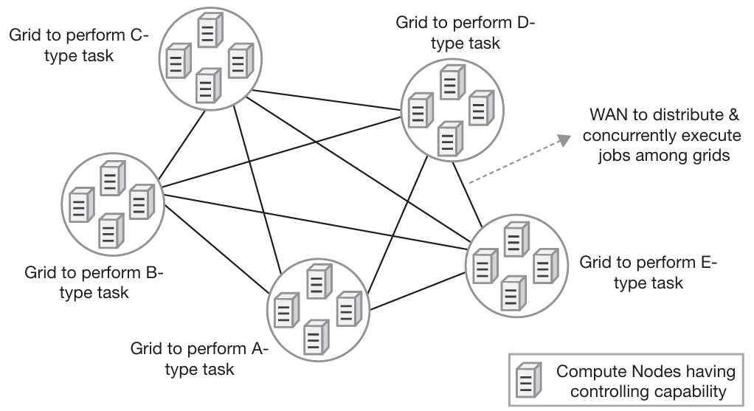
Evolution OF CLOUD COMPUTING : Grid Computing
Grid Computing: Decentralization of Control
Grid computing removed the dependency on a single cluster head, decentralizing control.
It introduced heterogeneous systems (different hardware/software) into the same computing grid.
Grid computing scaled distributed systems across geographic locations and administrative domains.
Early 1990s

Slide 48
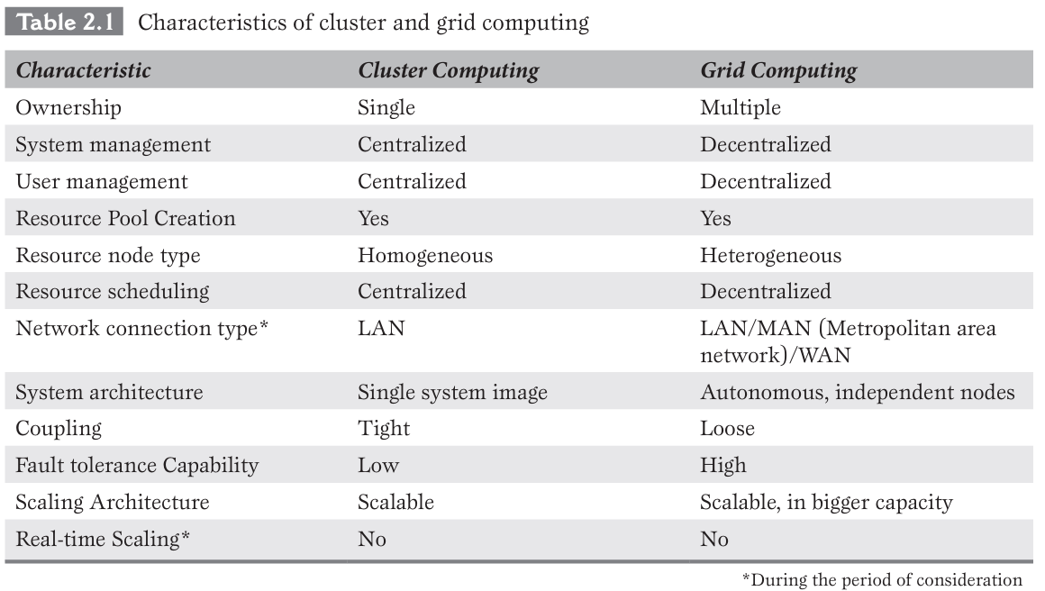
Evolution OF CLOUD COMPUTING : CLUSTER VS Grid Computing

Slide 49
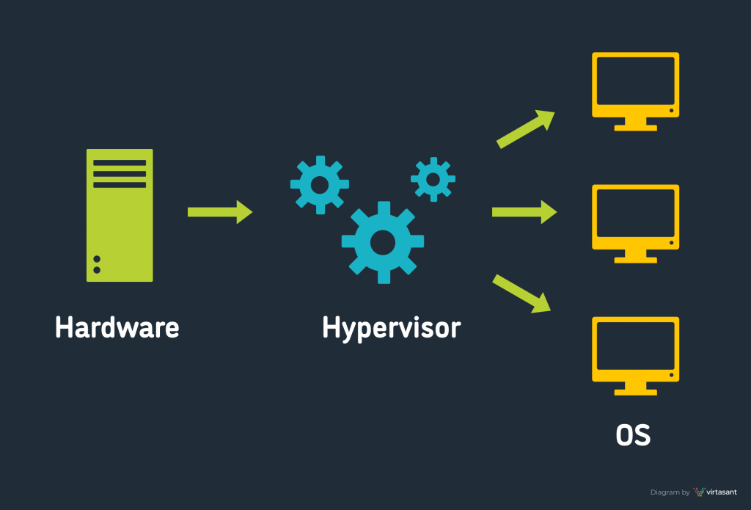
Evolution OF CLOUD COMPUTING : Hardware Virtualization
Hardware Virtualization: Weapon for Designing Dynamic Computing Systems
Virtualization decoupled software from physical hardware, enabling dynamic resource allocation.
Virtual machines (VMs) allowed real-time scaling, increasing system flexibility and scalability.
Virtualization was a key factor in the growth of cloud computing, enabling efficient resource management.

Slide 50
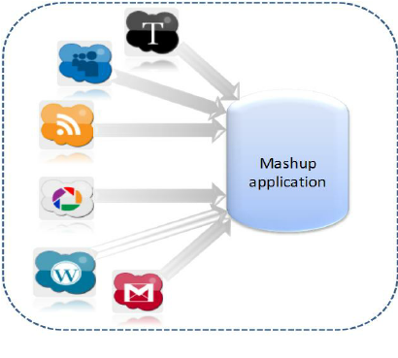
Evolution OF CLOUD COMPUTING : Advancement in Web Services
Advancement in Web Services: Ease in Group Collaboration
Web services enabled real-time collaboration across distributed systems.
Web 2.0 and Mashup technologies made it easier to combine data from different platforms and share user-generated content.
This facilitated large-scale collaboration over the internet.
2002

Slide 51
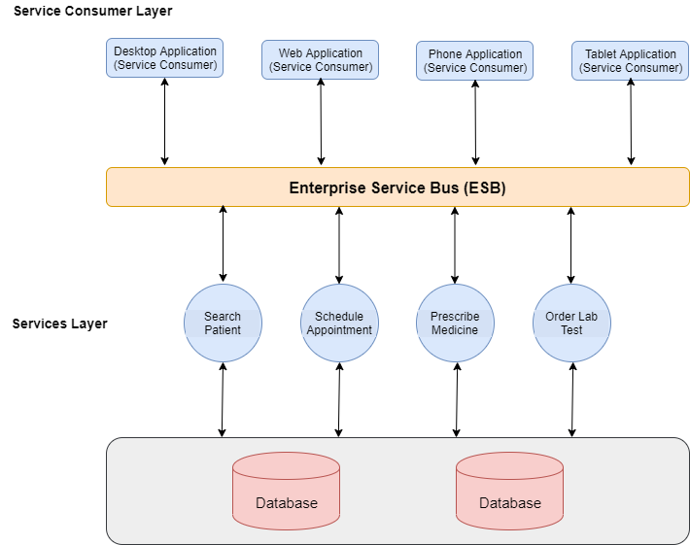
Evolution OF CLOUD COMPUTING : Service-Oriented Architecture
SOA (Service-Oriented Architecture): Flexible Software Design Model
SOA allowed the creation of loosely coupled services that could be reused across applications.
Web services integrated these services, making it easier to develop large distributed applications.
This model supported cloud service delivery.

Slide 52
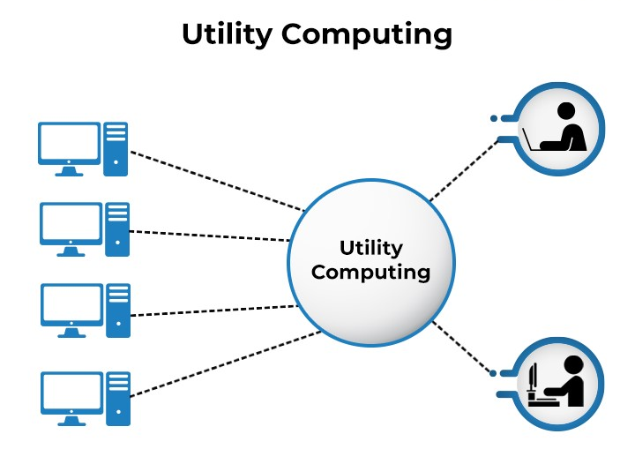
Evolution OF CLOUD COMPUTING : Utility Computing
Utility Computing: A Pay-as-You-Go Model
Utility computing introduced the concept of delivering computing resources as a service, similar to utilities like water or electricity.
Users paid only for what they used, making computing more cost-efficient.
This model laid the foundation for cloud service models (IaaS, PaaS, SaaS).
Utility Computing is the packaging and delivery of computing resources, similar to traditional public utilities like electricity, water, or telephone. The model follows pay-per-use mode of payment and on-demand service facility.

Slide 53
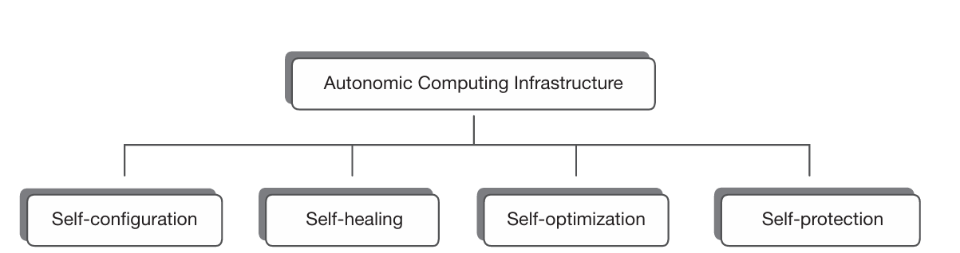
Evolution OF CLOUD COMPUTING : Autonomic Systems
Autonomic Systems: Self-Management in Computing Systems
Autonomic systems were designed to manage themselves without human intervention.
They handled monitoring, resource optimization, and recovery autonomously.
This concept was crucial for the development of self-scaling and self-healing cloud systems.

Slide 54
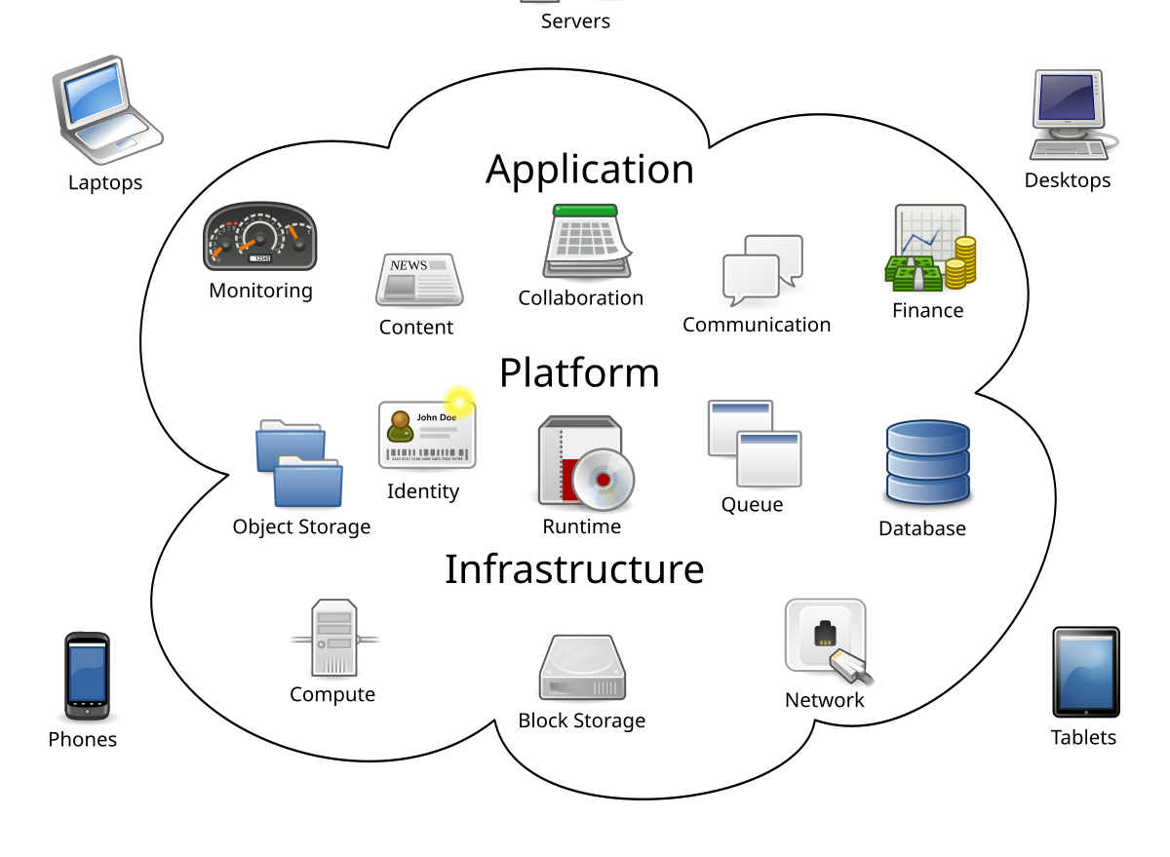
Evolution OF CLOUD COMPUTING : Cloud Computing
Emergence of Cloud Computing
Cloud computing is a combination of advancements in virtualization, distributed systems, grid computing, and utility computing.
It allows on-demand access to shared computing resources over the internet.
Cloud computing offers scalability, flexibility, and cost-efficiency, making it a preferred model for modern computing.

Slide 55
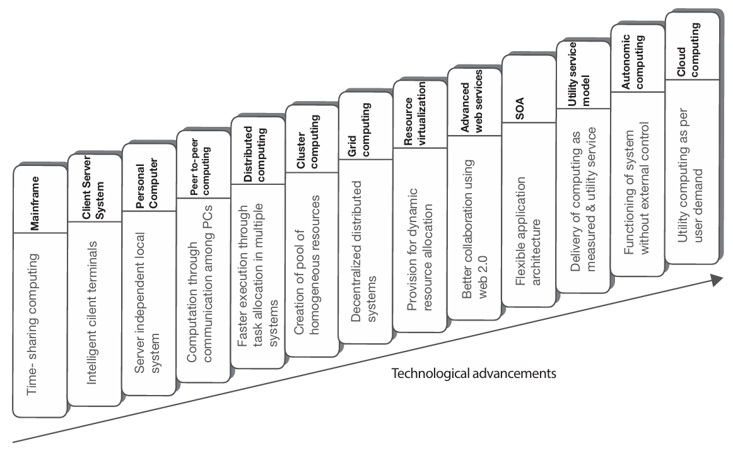
Evolution OF CLOUD COMPUTING

Slide 56
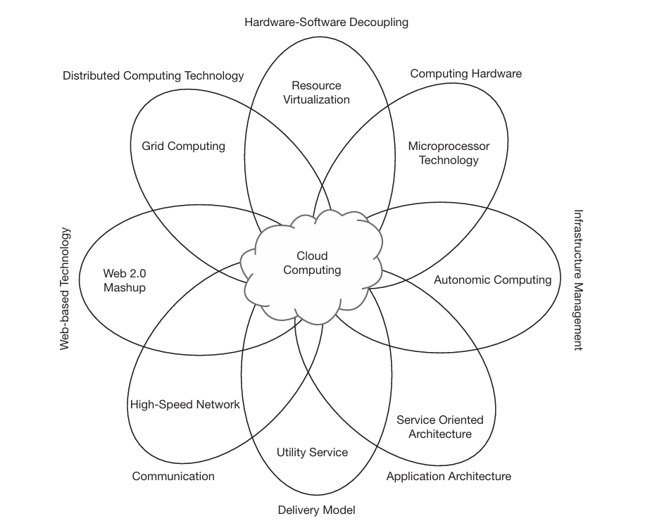
Evolution OF CLOUD COMPUTING

Slide 57
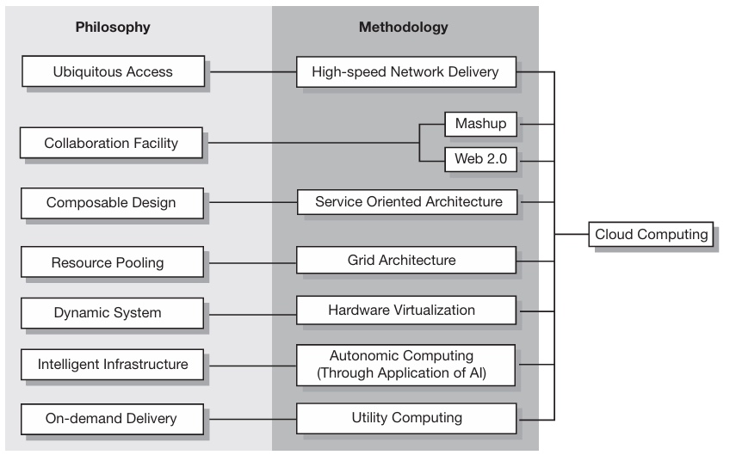
how philosophies have converged into cloud computing
Ubiquitous Presence of Computing:
Computing resources available from any location, at any time.
Achieved through cloud infrastructure providing remote access and multi-device support.
Collaboration Among Users:
Cloud platforms enable real-time collaboration across different locations.
Implemented via tools like Google Docs, Microsoft 365, and collaborative software hosted on the cloud.
Composable Design Pattern:
Systems are designed using a service-oriented architecture (SOA).
Components can be reused and recomposed to create flexible applications.
Resource Pooling:
Shared infrastructure to serve multiple users efficiently.
Virtualization technology helps in the pooling of resources for dynamic allocation.
Dynamic System Architecture:
Elastic scaling based on demand without manual intervention.
Enabled by auto-scaling features and load balancing in cloud systems.
Intelligent Infrastructure:
Systems can intelligently manage resources and self-heal.
Achieved through AI-driven operations, automated monitoring, and management.
On-Demand Delivery:
Resources are provided as needed without upfront investments.
Implemented via pay-per-use models and automated provisioning in cloud services.

Slide 58
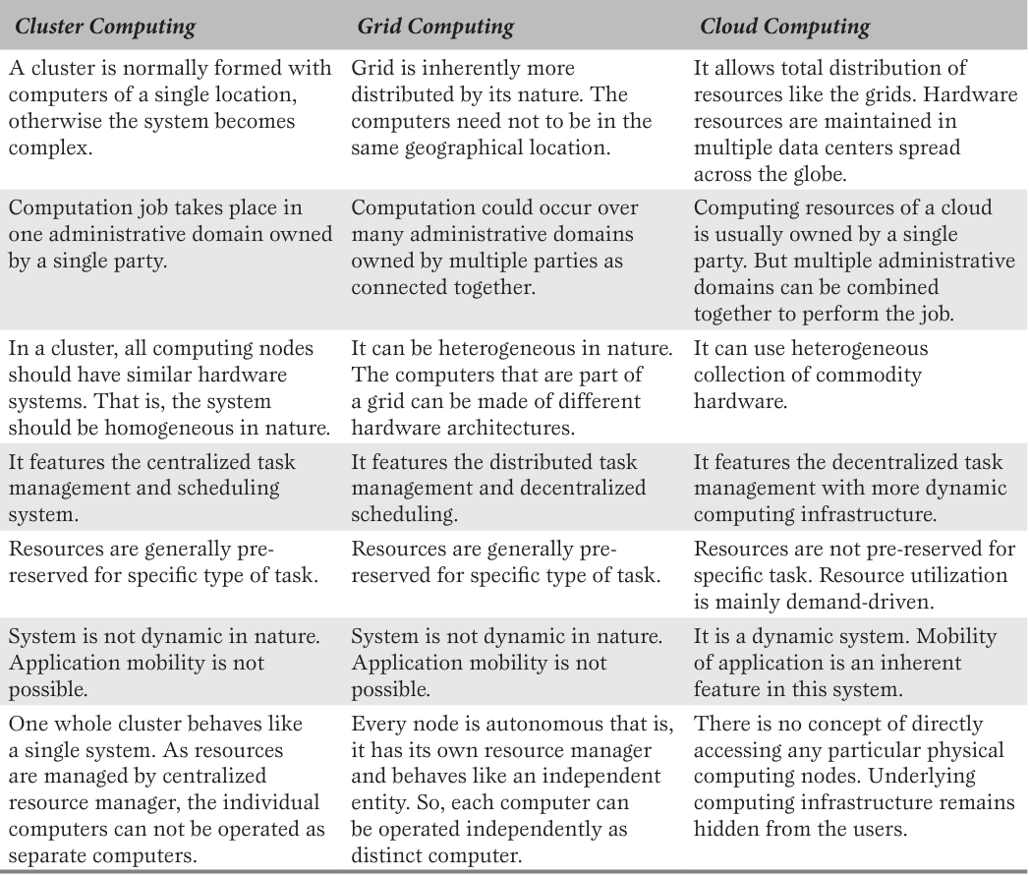
COMPARISON BETWEEN CLUSTER, GRID AND CLOUD COMPUTING

Slide 59
CHAPTER 3 BENEFITS & CHALLENGES
|Cloud Computing

Slide 60

ORIGIN OF THE TERM ‘CLOUD COMPUTING’
The term ‘cloud computing’ appeared in the market with its present meaning in the year 2006.

Slide 61
ORIGIN OF THE TERM ‘CLOUD COMPUTING’
Network Cloud (1990s):
In early network designs, engineers used cloud symbols in diagrams to represent unknown parts of the network.
This was called the "network cloud," but it didn’t refer to cloud computing as we know it today.
Utility Computing Initiatives:
Towards the end of the 20th century, utility computing was the focus of major software firms, aiming to deliver applications over the Internet.
Email services and platforms like Salesforce (in 1999) offered business applications over the Internet, marking early steps towards cloud-based services.

Slide 62
ORIGIN OF THE TERM ‘CLOUD COMPUTING’
Emergence of Cloud Computing (2006):
The term "cloud computing" began being used in the early 2000s by those involved in utility computing.
Official recognition came in 2006 when Google's CEO Eric Schmidt used it in a public forum.
In the same year, Amazon introduced its Elastic Compute Cloud (EC2), bringing cloud computing into the commercial market.
Etymology of the Term "Cloud":
The word "cloud" refers to something obscure or hidden.
The term likely symbolizes a collection of computing resources where the inner workings are hidden from users, offering abstracted services without revealing the complexity behind them.

Slide 63

Early Initiatives
1. Salesforce.com (1999):
Launched the first successful commercial initiative to deliver enterprise applications via a regular website.
This marked a turning point, encouraging other firms to explore cloud-based business applications.
2. Amazon Web Services (AWS) (2002):
AWS introduced computing services over the Internet, offering a suite of services including storage.
This solidified the utility computing model, pushing firms to modernize their data centers.

Slide 64
Early Initiatives
3. Elastic Compute Cloud (EC2) (2006):
Amazon launched EC2, allowing companies and individuals to rent virtual machines to run their applications.
This was the first major cloud service offering and is seen as the concrete birth of modern cloud computing.
4. Google Docs (2006):
Google introduced Google Docs, popularizing cloud services for the public by offering online document editing and collaboration.

Slide 65
Initiatives
5. Force.com (2007):
Salesforce launched Force.com, allowing users to build applications and launch websites, pushing further into cloud platforms.
6. Windows Azure (2009):
Microsoft entered the cloud computing space with Windows Azure, enabling customers to run Windows applications over the Internet.
7. NASA's Nebula (2008):
NASA launched Nebula, an open-source cloud platform for internal use, contributing to cloud research and development.
8. Data Center Modernization:
As cloud computing emerged, many firms began modernizing their data centers to support the utility computing model.

Slide 66

Utility Computing
Definition of Utility Computing:
A vendor provides and maintains computing resources, delivering them to subscribers on-demand.
Subscribers pay based on usage, either through fixed rental or actual use-based billing models.
Key Features of Utility Computing:
On-Demand Service: Subscribers access the required computing facilities as needed.
Metered Service: Usage is metered, and charges are based on consumption.
Cost Reduction: Sharing resources among many subscribers leads to reduced computing costs.
Billing Models:
Fixed Rental: Subscribers pay a fixed amount for a set period, typically monthly.
Actual Use-Based: Billing depends on the actual service usage by the subscriber.

Slide 67

Utility Computing
Benefits for Subscribers:
Cost Efficiency: Reduced IT operational costs by outsourcing computing facilities.
Flexible Investment: Shifts from large upfront investments to smaller, variable payments.
Access to Expertise: Avoids the need for in-house expertise, leveraging the provider's specialized knowledge.
Benefits for Providers:
Return on Investment (ROI): Providers can serve many users with the same infrastructure, maximizing ROI.
Scalability: The utility model enables scalability, offering services in varying volumes based on demand.

Slide 68
Utility Computing
Comparison to Traditional Models:
In the past, organizations maintained their own data centers or outsourced computing within their premises, incurring higher costs.
The cloud computing model represents a shift, offering outsourced computing resources in a more flexible and cost-effective form.
Notable Utility Computing Initiatives:
IBM, HP, and Sun Microsystems led utility computing research towards the end of the 20th century.
Later, companies like Microsoft, Google, and Amazon joined the market with cloud-based solutions.
Overall Advantages:
Low Initial Investment: The utility model allows subscribers to access computing power without heavy upfront costs.
Operational Savings: Outsourcing to reputable providers ensures expertise and reduces the complexity of maintaining IT operations.

Slide 69
METERING AND BILLING IN CLOUD
Accurate Metering in Cloud Computing:
Cloud computing enables precise measurement of service usage, which wasn't fully possible in earlier models like cluster computing.
Technological Advancements:
Cloud computing incorporates technologies that support the accurate measurement of resource consumption, allowing for real-time tracking of usage.
In traditional computing, the basic metering functions were not adequate for measuring the actual use of computing. Cloud computing is empowered with this facility

Slide 70
METERING AND BILLING IN CLOUD
Types of Metered Resources:
Processing Power: Subscribers are billed based on CPU and memory usage.
Storage: Costs are based on the actual volume of data stored.
Network Bandwidth: Charges apply according to the bandwidth consumed over time.
Billing Model:
Subscribers are billed based on actual usage of computing resources such as processing, storage, and bandwidth, ensuring they only pay for what they use.
Cost Savings:
Precise metering results in more efficient cost management for users, avoiding overpayment for unused resources.
Advantage Over Traditional Systems:
Traditional models lacked the ability to accurately meter resource usage, whereas cloud computing provides detailed, transparent metering of each resource type.

Slide 71
SEPARATION OF DATA CENTER OPERATION
Burden of Data Center Operations:
Enterprises traditionally handled infrastructure setup, electricity, cooling, system maintenance, upgrades, and security, which was a significant burden.
Traditional Model:
In the traditional computing model, managing data centers was often outsourced to specialists to ease the load on internal teams.
Cloud Computing Separation:
Cloud computing fully separates data center operations from the user’s computing tasks, allowing users to focus solely on application development and usage.

Slide 72
SEPARATION OF DATA CENTER OPERATION
Data Centers in Cloud Computing:
The data centers are remotely located and managed by cloud service providers, who handle all operational tasks such as maintenance, security, upgrades, and power supply.
Relief for Users:
This separation relieves users from the complexities of infrastructure management, allowing them to concentrate on their core tasks like software development and business operations.
Vendor Responsibilities:
Cloud vendors are responsible for the entire management of the data center infrastructure, including recovery, protection from attacks, and resource scalability.

Slide 73
BENEFITS OF CLOUD COMPUTING
Less Acquisition/Purchase Cost:
Cloud computing reduces the initial capital investment by eliminating the need for purchasing extensive hardware or software resources upfront.
Reduced Operational Cost:
Operational costs like system maintenance, administration, and energy support are shifted to cloud providers, significantly reducing the user’s financial burden.
Reduced System Management Responsibility:
System management tasks such as updates, recovery, and security are handled by the cloud vendor, freeing the user from these responsibilities.
Use-basis Payment Facility:
Cloud users are billed based on actual consumption, making it more cost-effective and flexible compared to fixed costs.
Unlimited Computing Power and Storage:
Users can access scalable computing power and virtually unlimited storage, making it accessible even for smaller businesses.

Slide 74
BENEFITS OF CLOUD COMPUTING
Quality of Service (QoS):
Renowned cloud vendors provide reliable, high-quality service, ensuring consistent performance.
Reliability:
Cloud vendors handle critical functions like load balancing, backups, and recovery, making the service more reliable than traditional setups.
Continuous Availability:
Cloud services offer high uptime (99.9%), ensuring near 24/7 availability for users.
Locational Independence:
Users can access cloud services from anywhere with an internet connection, providing flexibility and convenience.
High Resiliency:
Cloud infrastructures are resilient to attacks and disruptions due to redundancy and other protective measures.

Slide 75
BENEFITS OF CLOUD COMPUTING
Quick Deployment:
Cloud computing allows rapid deployment of applications and services, giving businesses a competitive edge.
Automatic Software Updates:
Software updates are automatic, ensuring users always have the latest version without manual intervention.
No License Procurement:
Users pay for software as they use it, eliminating the need for long-term software licensing agreements.
Safety against Disaster:
Cloud services have robust recovery systems, ensuring data and systems are better protected against disasters.
Environment Friendly:
Cloud computing minimizes resource usage and reduces e-waste, contributing to a lower carbon footprint.

Slide 76
CHALLENGES OF CLOUD COMPUTING
Limited Portability between Cloud Providers:
Proprietary cloud platforms make it difficult to move applications between different cloud providers due to vendor lock-in, limiting portability.
Interoperability Problem:
Proprietary standards restrict applications from different cloud vendors from working together, creating interoperability issues when using multiple cloud platforms.
Data Security:
Storing data outside a user’s network boundary introduces vulnerabilities, as security is largely dependent on the cloud vendor.
Reduced Control over Governance:
Cloud users have limited control over the governance and operational policies of the cloud, which is managed by the vendor.
Multi-Regional Compliance and Legal Issues:
Legal and privacy concerns arise when data is stored in different geographical regions, as laws vary across jurisdictions regarding data disclosure and compliance.
Bandwidth Cost:
While cloud services reduce overall costs, the additional expense of network bandwidth, especially for data-intensive applications, can increase total costs.

Slide 77
How Cloud Computing Addresses Business Challenges
Cloud computing addresses business challenges by offering:
Flexibility: Provides scalable and adaptable computing environments.
Cost Efficiency: Reduces initial capital expenditures and operational costs.
Resource Management: Outsources infrastructure management to vendors, reducing the burden on businesses.

Slide 78
Ethical Issues in Cloud Computing
Accountability: Issues arise from the blurred lines of responsibility between cloud vendors and users.
Data Security: Cloud vendors must ensure robust protection of sensitive data.
Intellectual Property: Cloud vendors need to handle intellectual property responsibly.

Slide 79
Cloud Computing: Network as Computer
Concept: Cloud computing can be seen as a vast network of computers that users view as a single entity.
Philosophy: Reflects Sun Microsystems' slogan, "The network is the computer," combining computing power from multiple systems.

Slide 80
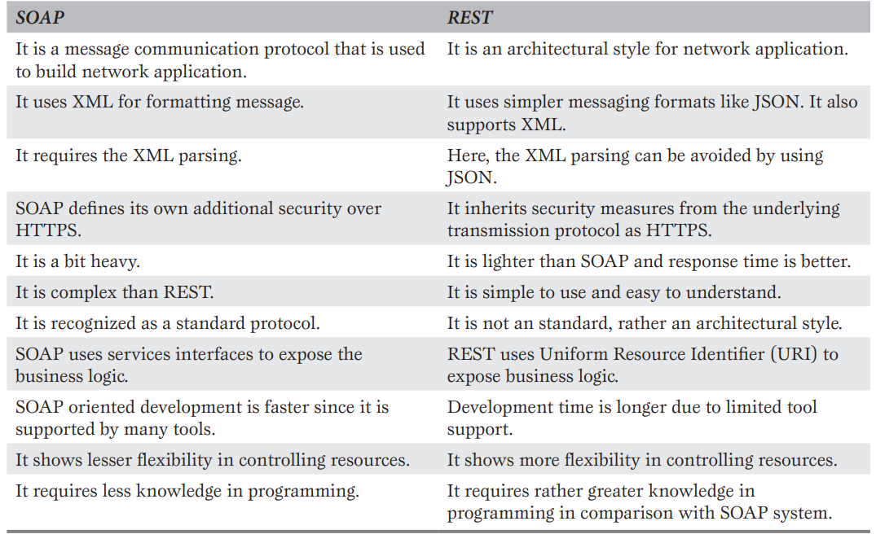
Role of Web Services
Definition: Web services enable communication between software systems over a network, using standardized methods.
Categories:
SOAP (Simple Object Access Protocol): A protocol for exchanging structured information.
REST (Representational State Transfer): An architectural style for designing networked applications.

Slide 81

Role of APIs
Definition: APIs (Application Program Interfaces) provide a standard way for software components to interact.
Types:
IaaS APIs: For resource configuration and management.
PaaS APIs: For integrating with platform services.
SaaS APIs: For integrating with software applications.
Function: APIs facilitate access to cloud services and ensure compliance.

Slide 82
Ubiquitous Cloud
Definition: Ubiquitous computing refers to making computing available everywhere, often through smart devices.
Role of Cloud Computing: Enhances the concept of ubiquitous computing by providing resources from anywhere at any time.

Slide 83
Confusion Between Cloud and Internet
Difference: While cloud computing is delivered via the Internet, it is distinct from traditional web access.
Characteristics: Cloud computing offers utility-based, scalable, and measurable computing services beyond static or dynamic web content.
Cloud and Internet are not same.
Internet is a means for accessing cloud.

